Slide 1
Caseless Amunition
By: Drew Sorensen

Slide 2
Overview
History
Plan and Implementation
Upsides/Pros
Downsides/Cons
Summary

Slide 3
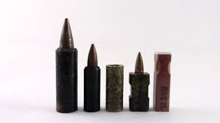
History
First Modern Day Ammunition Created by Germany during WW2
Experiments had some success but not enough to warrant the full change to caseless ammunition
Heckler & Koch created first successful caseless ammunition in their G11 created in 1977
Notes:
First Moden Casless Ammo created in germany but not extensively researched till 1977 by H&K

Slide 4
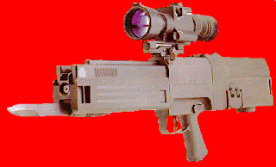
Plan and Implementation
Nazis orgignally planned to implement caseless ammuniton but abandoned the project due to lack of weather resistance
Heckler & Kochs G11 went through successful experimentation but was deemed not combat ready due to the ammunitions fragility and lack of practical use
Notes:
Plan was for the ammo to be light and transported in the mass compared to conventional ammo

Slide 5
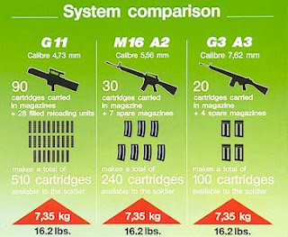
Upsides/Pros
The biggest upside was the money saved from not having to use brass casings that became useless after the firing of the weapon
The ammunition was also lighter which meant that a larger quantity could be transported
Special ops missions could benefit due to the fact that they were caseless and wouldn't have to worry about leaving evidence behind
Notes:
Light and Small ammo could be transported easier and special ops could benifet due to no cases being left behind leaving no trace

Slide 6
Downsides/Cons
The ammunition was very fragile
The ammunition could be corrupted or destroyed by dirty or oily hands that could jam or damage the weapon
The ammunition could misfire very often, the metal casings in conventional weapons would act as a heatsink, but without the heatsink the heated up barrel after firing multiple rounds could “fire the bullet” without a trigger pull
Notes:
Ammo was fragile and not good in harsh weather conditions ammo could misfire due to no heatsink capabilities

Slide 7
Summary
In summary the idea of caseless ammunition is a good one but implementing it is a big challenge, Caseless ammunition is difficult to work with due to its fragile and poor weather resistance capabilities. Though caseless ammunition could save many millions. The brass casing cannot be beat when it comes to its durability on and off the combat field whether its is incredible wether resistance. Though the idea is good the outcome and experimentation proved otherwise
Notes:
Good idea but turned out bad after extensive expermintation

Slide 8
Sources
https://weaponsandwarfare.com/2019/09/25/caseless-cartridge/
http://futurewarstories.blogspot.com/2012/10/fws-armory-caseless-ammunition.html

